Slide 1



X
Performance Analytics
Analisis Kinerja Bisnis Kimia Farma Tahun 2020-2023
Kimia Farma - Big Data Analytics
Presented by
Anandha Krishna

Slide 2





I G A G Ngurah Anandha Krishna, B.Sc.
Ex Project Assistant in IT Consultant | Jobseeker
A 3 years experienced former Project Assistant for IT Consultant and Research Assistant in Berlin, Germany with a Bachelor’s Degree in Transportation Planning from Technical University Berlin.
With skills in Project Management, Research, Financial Analysis, and further SQL and Business Intelligence, together we can fulfill our goals in creating a sustainable and developed Indonesia.
Jakarta Utara
anandha@seraya.org
Anandha Krishna | LinkedIn

Slide 3

About Company
PT Kimia Farma Tbk is a state-owned company operating within the pharmaceutical industry in Indonesia and several other countries.
One of the first companies that became Kimia Farma was established by the colonial Dutch East Indies government in 1817, initiating a long tradition as the first and oldest pharmaceutical company in Indonesia.
In 1958, the Indonesian government nationalized several Dutch-owned companies and merged these companies into the PNF Bhinneka Kimia Farma, the direct predecessor of PT Kimia Farma.
With a long history of tradition and expertise gathered in hundreds of years, Kimia Farma has grown into an integrated healthcare company, supporting Indonesia’s development within its role in fostering healthy Indonesians.

Slide 4
Project Portfolio
As a business, Kimia Farma has managed to operate between 2020-2023 across Indonesia, selling various kinds of products and amass a huge amount of data associated with the sale of these products.
Therefore, there is a necessity for a Big Data Analytics Intern at Kimia Farma to understand and analyse these data associated with the sale of products, and further evaluate the business performance of Kimia Farma between 2020-2023.
One of the supporting tools to help evaluate business performance of companies with huge amount of data is a business intelligence dashboard. Therefore, a dashboard is created with the aim to visualize the collected data and present findings related to the business performance.

Slide 5
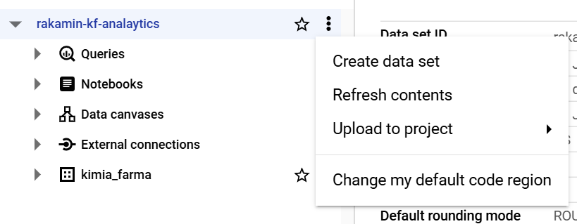
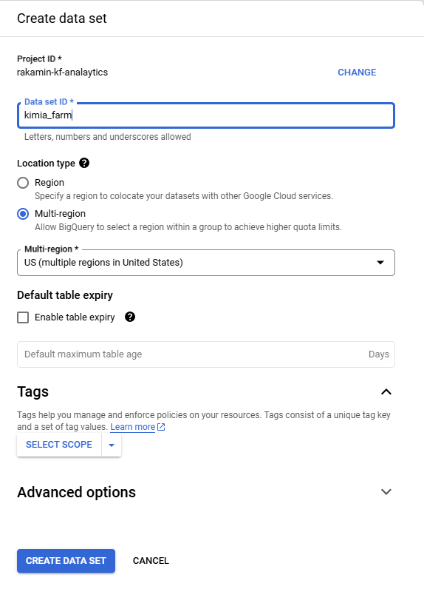
Importing Dataset to BigQuery
Choose the appropriate project in BigQuery Studio
Click the three dot button beside the project name
Type the data set name in the ‘Data set ID’ field
Click the ‘Create Data Set’ button to create the Data Set

Slide 6
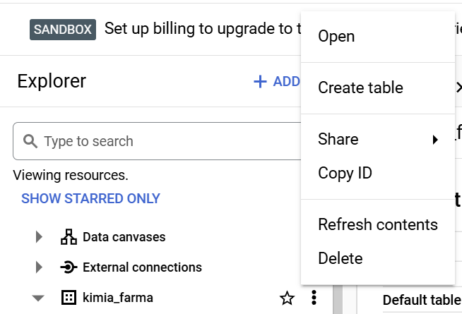
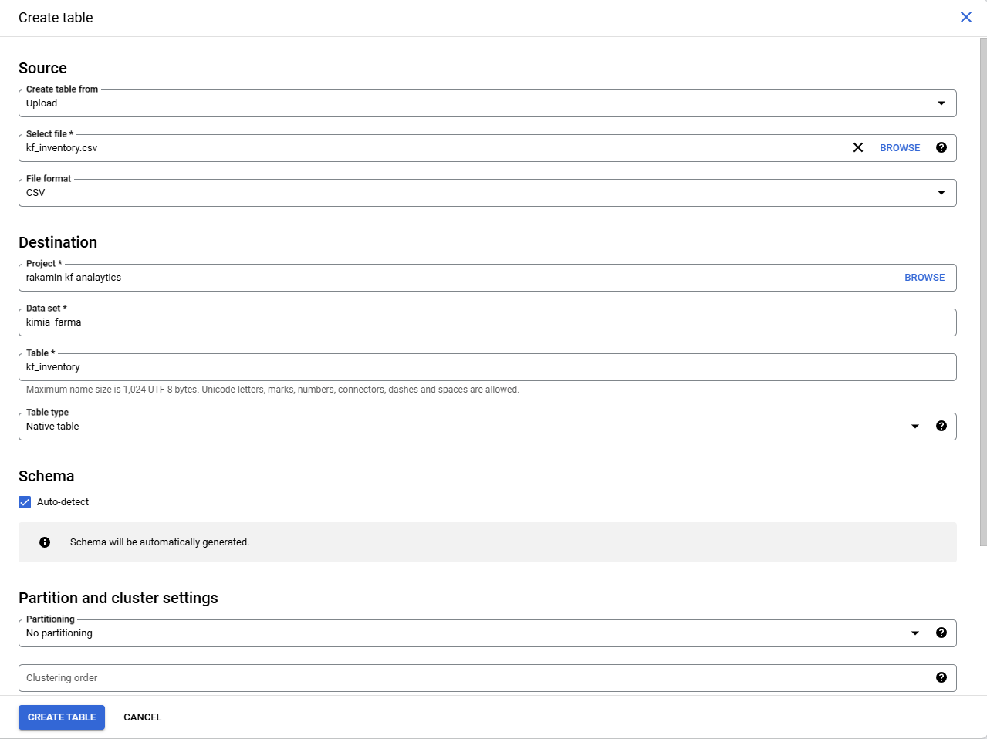
Importing Dataset to BigQuery
Choose the appropriate data set (‘kimia_farma’) in BigQuery Studio
Click the three dot button beside the data set name
Choose the source of the dataset in ‘Create table from’
Select the file
Type the table name in the ‘Table’ field
Click the Auto-detect box in Schema
Click the create table button

Slide 7
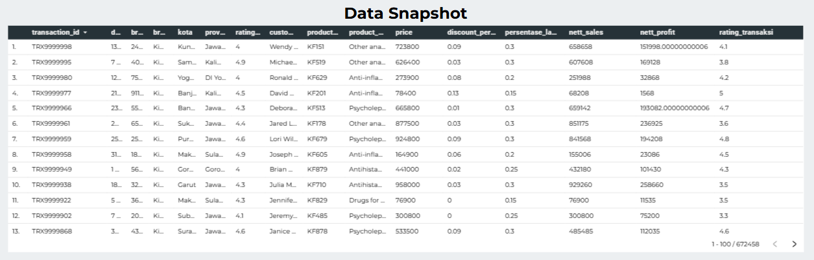
Analysis Table
Data from various datasets were merged into 16 columns
Data for 13 columns were directly taken from other datasets, the remaining 3 (persentase_laba_gross, nett_sales, and nett_profit) were calculated
Snapshot taken from Google Data Studio

Slide 8
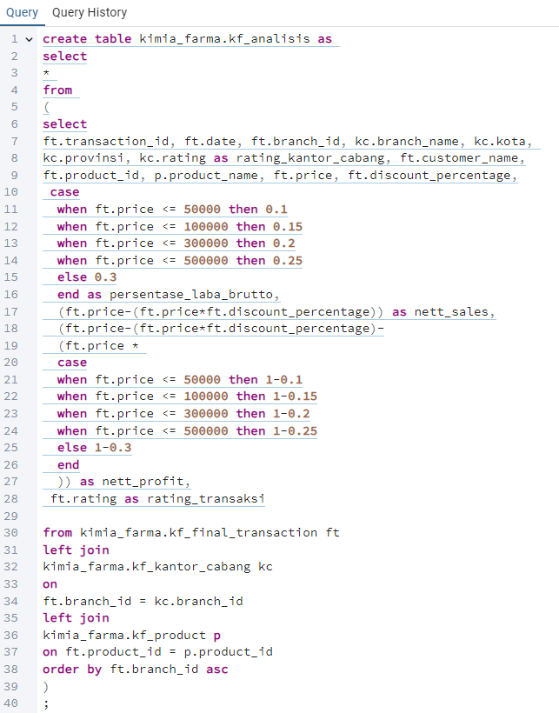
BigQuery Syntax
Overall Strategy:
(In another media) plan for the overall syntax, determine columns that can be directly filed using data available from the datasets.
Start to create and test the join syntax to fill the 13 columns with available data.
Determine that two of the remaining blank columns require special categorization
Persentase_laba_brutto: create case when syntax for the required categories

Slide 9
BigQuery Syntax
Overall Strategy:
Determine that two of the remaining blank columns require special categorization
Nett_sales: calculate using the following formula [Price - (Price*discount_percentage)]
Nett_profit: calculate using the following formula [Nett_sales - (Price * (1-persentase_laba_brutto)
The join queries were put in a subquery, for testing and further analysis purposes
Creation of the create table syntax that takes data from the subquery

Slide 10
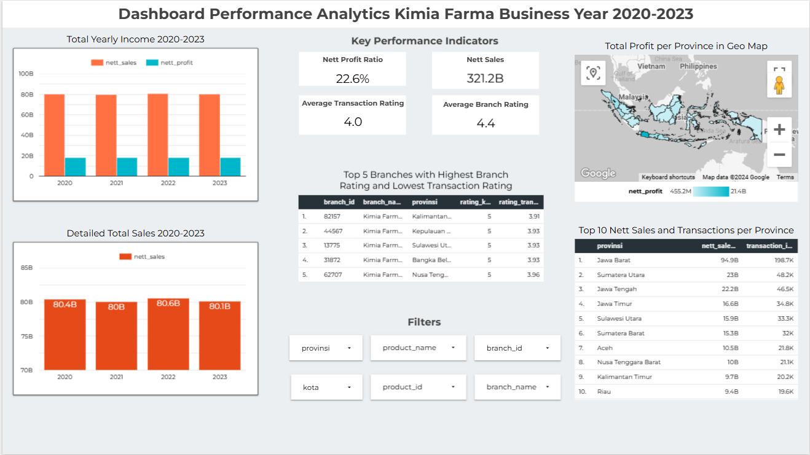
Dashboard Performance Analytics

Slide 11
Dashboard Performance Analytics
Analysis:
Overall strong performance throughout 2020-2023
Nett sales and nett profit remains relatively stable in 4 years
Differences in nett sales and nett profit between 2020-2023 are negligible

Slide 12
Dashboard Performance Analytics
Analysis:
Key Performance Indicators for business performance analysis summary
Nett Profit Ratio of 22,6%
Average Branch Rating higher than Average Transaction Rating, requiring further analysis on the customer experience
Several branches have excellent branch ratings but < 4 average transaction ratings
Several filters for specialized analysis, these filters will affect all indicators

Slide 13

Dashboard Performance Analytics
Analysis:
Geo Map helps fast analysis on the areas with highest total profit for the company
Jawa Barat has both the highest nett sales and transaction frequency, remains a strong market for Kimia Farma
Nett sales and transaction frequency are linked together, with almost uniform sales per transaction

Slide 14
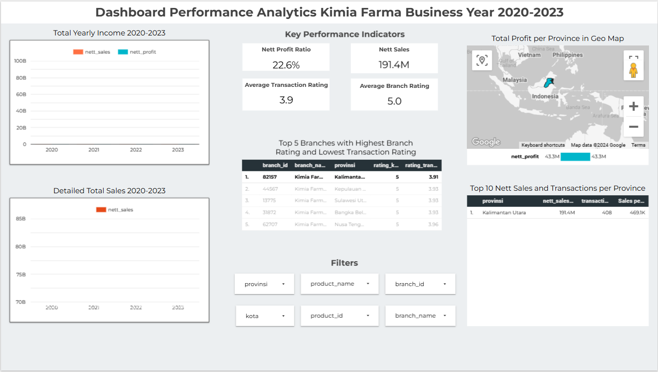
Dashboard Performance Analytics
Possible direct filtering in clicking the desired indicator
In this example, the branch ID 82517 was clicked
Returning to default state would only require a click on the same field

Slide 15
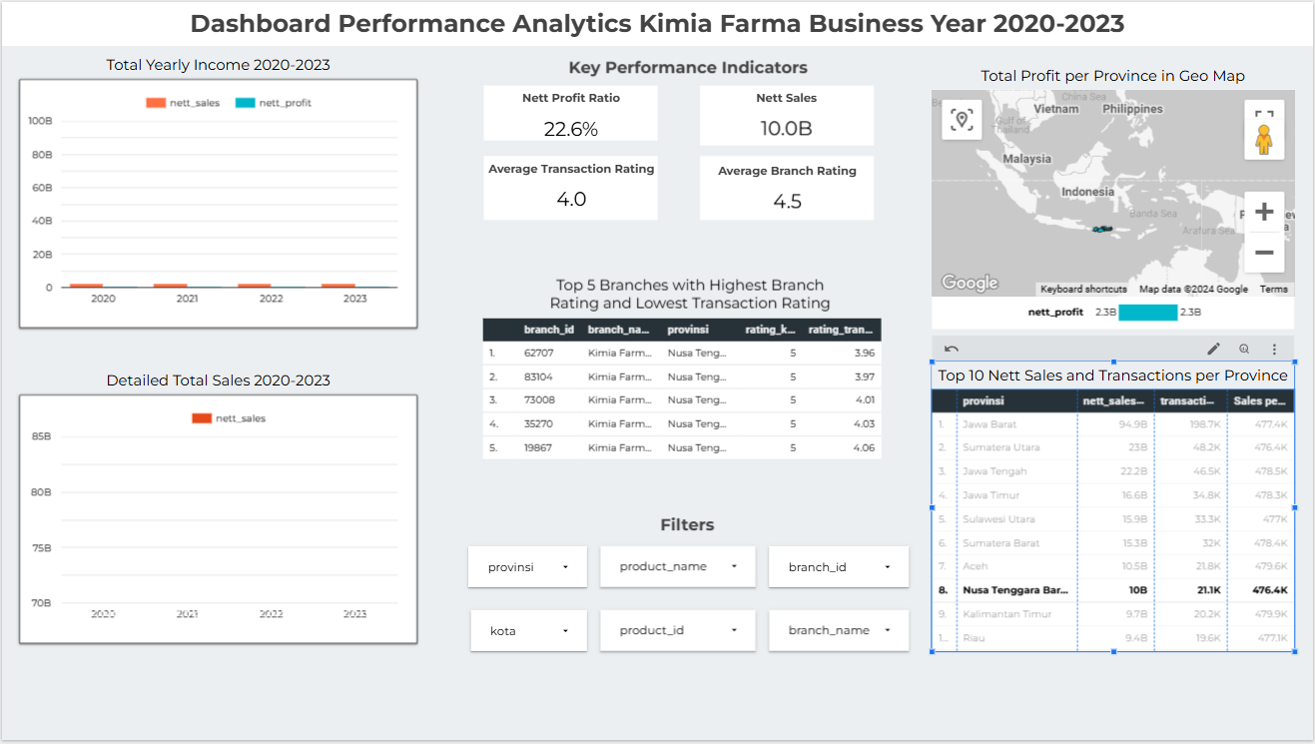
Dashboard Performance Analytics
Possible direct filtering in clicking the desired indicator
In this example, the province Nusa Tenggara Barat was clicked
Returning to default state would only require a click on the same field

Slide 16
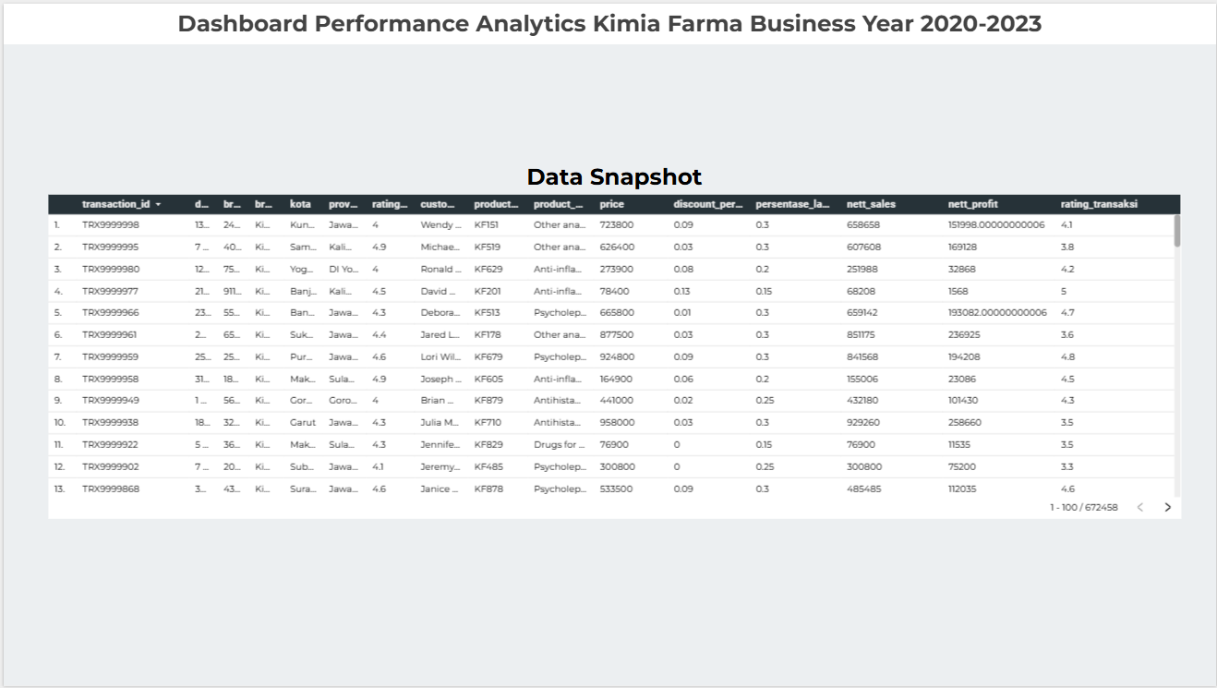
Dashboard Performance Analytics

Slide 17
Links
Google Drive Video
Github
nandosian/Big-Data-Analytics-Challenge-: Dibuat untuk tugas akhir Project Bashed Internship Data Analytics Kimia Farma di Rakamin Academy. (github.com)
https://drive.google.com/drive/folders/1j_6FW-HAMFqZ1d6TCoH66eOAbkQJMn5E?usp=sharing
Dahsboard
https://lookerstudio.google.com/reporting/d6cc51ed-6255-4b55-84a4-f50a87ec0bb8

Slide 18
Thank You
X

